Slide 1
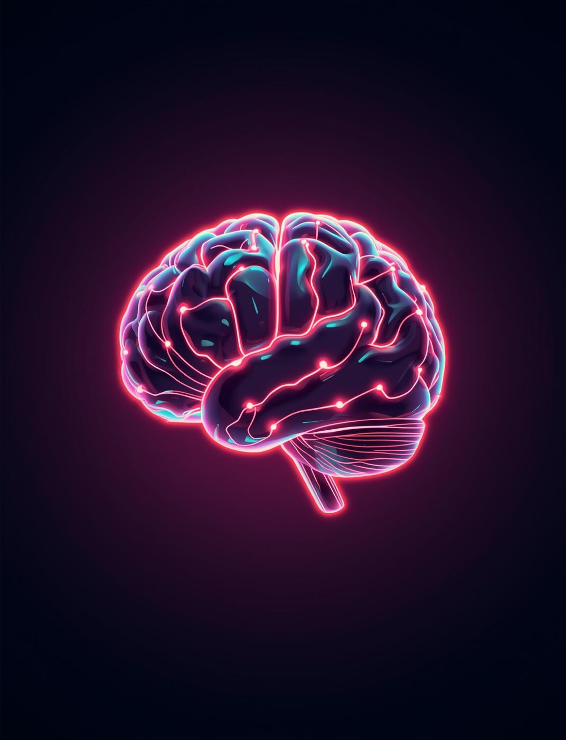
AI-Powered Customer Experience
Workflow Automation Assistant Presentation
[Presenter's First and Last Name]
[Professional Title or Role]

Slide 2


Modern Support Chaos
Today's customer support is overwhelmed by numerous simultaneous interactions, leading to inefficiencies and missed opportunities. Agents struggle to maintain consistency in responses and sentiment amid the chaos.

Slide 3

Why AI Matters
AI transforms workflows by enabling real-time multilingual understanding and emotional detection, significantly enhancing customer experiences while reducing manual effort and improving resolution times.

Slide 4
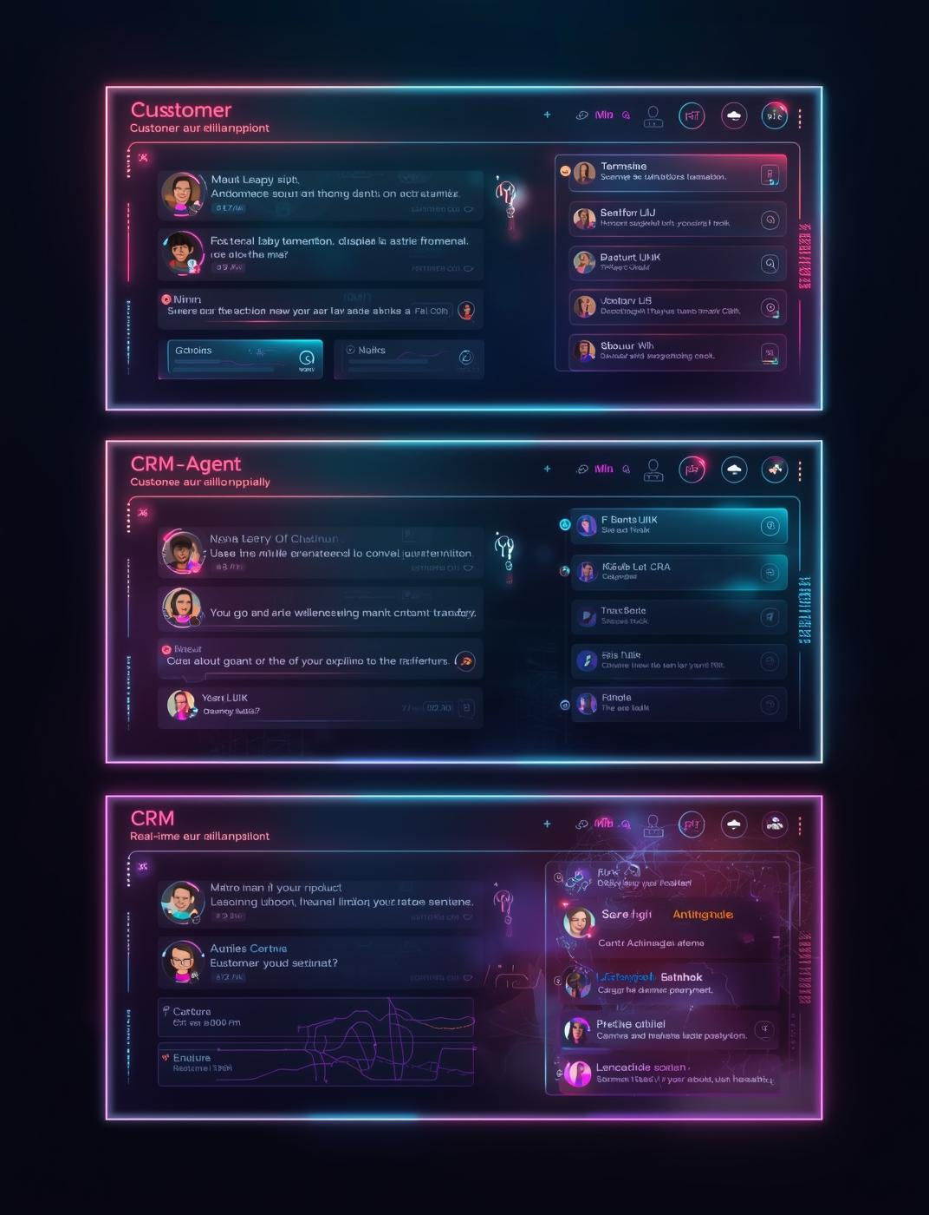
Our 2-Hour MVP
Intelligent Support Co-Pilot Overview
Our MVP features a Streamlit-based tri-panel UI that enables real-time sentiment analysis, multilingual translation, and automated CRM-ready summaries, significantly enhancing customer support operations.

Slide 5

High-Level Architecture
Our architecture features a modular design that enhances flexibility and scalability, integrating a Streamlit frontend with a robust Python backend, powered by the TCS GenAI Lab for intelligent processing.

Slide 6
Functional Workflows
01
02
03
Sentiment Agent
Translation Agent
Suggestion Agent
Interprets emotional tone and language.
Normalizes and returns multilingual outputs.
Drafts context-aware reply suggestions.

Slide 7
Demo Flow
01
02
03
Customer Message
Suggestions Generated
Agent Response
Customer sends message for assistance.
Copilot generates reply suggestions quickly.
Agent selects or customizes response.

Slide 8

Impact & Benefits
Faster Response
Reduces customer wait times significantly for support.
Enhancing customer support through automation
Higher Consistency
Ensures uniform service quality across all interactions.
Improved Satisfaction
Boosts customer happiness and loyalty through efficiency.
Enterprise Ready
Seamlessly integrates into existing business infrastructures.

Slide 9




Future Development Roadmap
Voice-to-Text
Callback Scheduler
Ticket System
Predictive Analytics
Implementing voice recognition for seamless interaction.
Automating callback scheduling for better customer experience.
Integrating ticketing system for issue tracking efficiency.
Utilizing data for enhancing customer retention strategies.

Slide 10

Meet the Team
AI Specialist
Backend Developer
Frontend Developer
Develops and implements AI models for enhanced customer interactions.
Creates robust server-side logic to support application operations.
Designs user interfaces for a seamless customer experience.
Data Analyst
QA/Compliance Officer
Analyzes user data to drive insights and improve workflows.
Ensures system quality and compliance with industry standards.

Slide 11

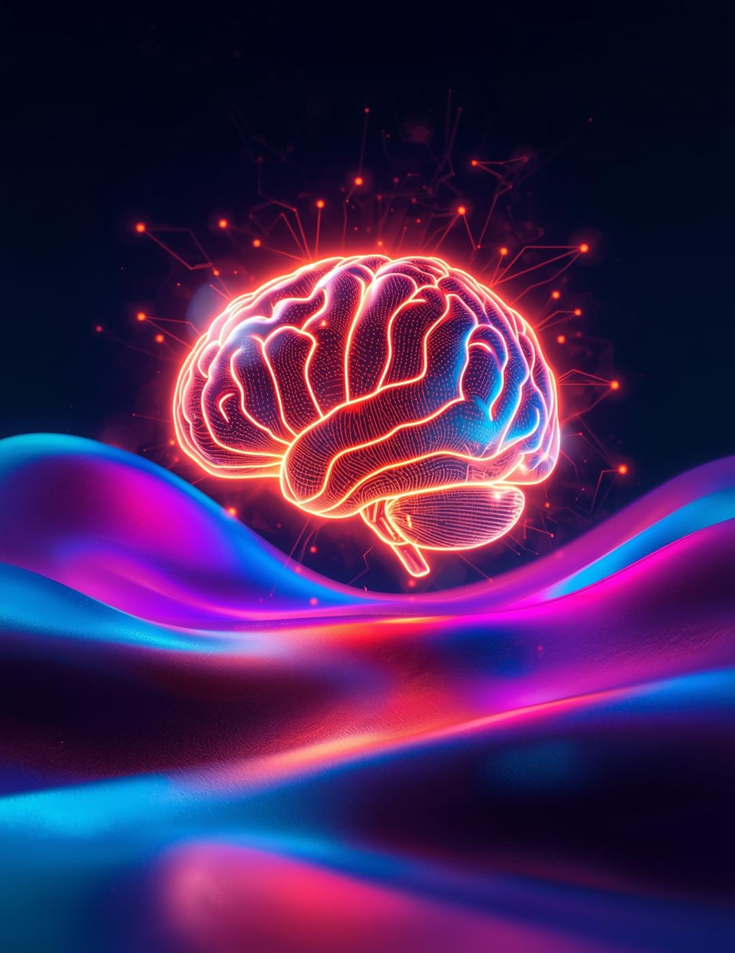
Contact Us
Email
hello@reallygreatsite
Social Media
@reallygreatsite
Phone
123-456-7890

